Slide 1
Introduction to “The Open Veins of Latin America”
Isabel Allende

Slide 2
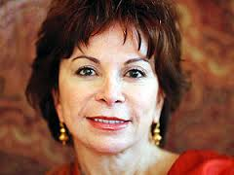
Isabel Allende

Slide 3
Isabel Allende born 2 August 1942) is a Chilean writer. Allende has been called "the world's most widely read Spanish-language author.
Allende's novels are often based upon her personal experience and pay homage to the lives of women, while weaving together elements of myth and realism.
Isabel Allende is best known for penning novels in the style of magic realism. She is the niece of former Chilean president Salvador Allende.

Slide 4
Several months after her uncle's assassination and the overthrow of Chile's coalition government in 1973, Allende left Chile and found refuge in Venezuela

Slide 5
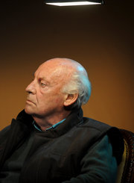
Eduardo Galeano
.

Slide 6
Eduardo Galeano is Uruguayan journalist, writer and novelist.
One of Latin America's most cherished and admired literary figures, Eduardo Galeano has raised his voice incessantly for human rights and social justice. As a teenager, he did many odd jobs such as working at factories, working as a typist, sign painter, bill collector and bank teller, to earn his living.

Slide 7
In 1973, a military coup took power in Uruguay; Galeano was imprisoned and later was forced to flee.
He settled in Argentina where he founded the cultural magazine, Crisis.
One of South America's most renowned writers, he has been an ambassador of Latin American history and has provided the world an insight into their culture, heritage and struggles, through his passionate and honest writing.

Slide 8
Open Veins of Latin America
This book tells how its inhabitants have in turn been the victims of genocide, exploitative trade deals and, more recently, a string of murderous US-backed dictators.
A continent blessed with bountiful natural resources has been systematically stripped of its gold, silver, tin, copper, oil, nitrates, manganese and rubber, while its people remain among the poorest on earth, with high levels of infant mortality, illiteracy and child prostitution.

Slide 9
Military coups
The United States has been involved in and assisted in the overthrow of foreign governments
Regime change has been attempted through direct involvement of U.S. operatives, the funding and training of insurgency groups within these countries,
US agencies working in secret sometimes mislead or do not fully implement the decisions of elected civilian leaders and that this has been an important component of many such operations

